Slide 1
統計學一上 R and RSAND
Hsin-Min Lu
盧信銘
台大資管系

Slide 2
Outline
R: A statistical computing tool
Meet RSAND

Slide 3
R for Statistics
We are going to use R as a computational tool.
We will talk about R in class.
You will need to use R to answer your homework.
You will need to submit some of the assignments to RSAND (rsand.lu.im.ntu.edu.tw) to be graded automatically.
You will need to use R in the final exam. ☼

Slide 4
Excel Strength
Excel vs. R (and SAS, Matlab, SPSS)
Excel provide a powerful direct manipulation environment.
User are guided through hints in GUI
WYSIWYG
Good for small, simple tasks
Can perform day-to-day data manipulation and analytics tasks
Can generate satisfactory graphs
Can be extended via Visual Basic for Applications (VBA) ☼

Slide 5

Excel Weakness
Excel, however, has several weakness.
Limited in data size: 1,048,576 rows by 16,384 columns.
VBA is extremely slow.
Spreadsheet-based solutions have trouble supporting reproducible results.
The consequence of the interactive natural of spread sheet applications.
Should I dump Excel?
No.
It is easy to use.
It covers 80% of the situations when you need to process a dataset.
But as an Information Management student, you need to know something that is more powerful than Excel
➔ R ☼

Slide 6
We are going to use R!
What is R anyway?
R is a dialect of the S language.
S is a language that was developed by John Chambers and others at Bell Labs.
S was initiated in 1976 as an internal statistical analysis environment—originally implemented as Fortran libraries.
In 1988 the system was rewritten in C and began to resemble the system that we have today (this was Version 3 of the language).
Version 4 of the S language was released in 1998 and is the version we use today. ☼
Notes:
The book Programming with Data by John Chambers (the green book) documents this version of the language.

Slide 7
R History
1991: Created in New Zealand by Ross Ihaka and Robert Gentleman.
1993: First announcement of R to the public.
1995: Martin Mächler convinces Ross and Robert to use the GNU General Public License to make R free software.
1996: A public mailing list is created (R-help and R-devel)
1997: The R Core Group is formed (containing some people associated with S-PLUS). The core group controls the source code for R.
2000: R version 1.0.0 is released.
2013: R version 3.0.2 is released on December 2013. ☼

Slide 8
R Features
Runs on almost any standard computing platform/OS (Windows, Linux, Mac, Solaris, HPUX, etc.)
Frequent releases (annual + bugfix releases); active development.
Functionality is divided into modular packages
Graphics capabilities very sophisticated and comparable (if not better) to most stat packages (if you know how to use it).
Useful for interactive work, but contains a powerful programming language for developing new tools
user -> programmer
Very active and vibrant user community; R-help and R-devel mailing lists and Stack Overflow ☼

Slide 9
Drawbacks of R
Essentially based on 40 year old technology.
Little built in support for dynamic or 3-D graphics (but things have improved greatly since the “old days”).
Functionality is based on consumer demand and user contributions. If no one feels like implementing your favorite method, then it’s your job!
Objects must generally be stored in physical memory; but there have been advancements to deal with this too
Not ideal for all possible situations (but this is a drawback of all software packages). ☼

Slide 10
Design of the R System
The R system is divided into 2 conceptual parts:
1. The “base” R system that you download from CRAN
2. Everything else.
The “base” R system contains, among other things, the base package which is required to run R and contains the most fundamental functions.
The other packages contained in the “base” system include utils, stats, datasets, graphics, grDevices, grid, methods, tools, parallel, compiler, splines, tcltk, stats4. ☼

Slide 11
R Packages
There are about 9000 packages on CRAN (as of Oct. 2016) that have been developed by users and programmers around the world.
People often make packages available on their personal websites; there is no reliable way to keep track of how many packages are available in this fashion.
There are also “Recommend” packages: boot, class, cluster, codetools, foreign, KernSmooth, lattice, mgcv, nlme, rpart, survival, MASS, spatial, nnet, Matrix ☼

Slide 12
Official R Resources
Available from CRAN (http://cran.r-project.org) (hard to read!)
An Introduction to R
Writing R Extensions
R Data Import/Export
R Installation and Administration (mostly for building R from sources)
R Internals (not for the faint of heart)
Recommended Books:
R in a Nutshell: A Desktop Quick Reference, by Joseph Adler (Oreilly)
Advanced R by Hadley Wickham (http://adv-r.had.co.nz/)
A long list of R books can be found here: http://www.r-project.org/doc/bib/R-books.html ☼

Slide 13
Why R?
I selected R because R has:
Growing use in academic research
Popular in industry
A relatively large and health community
High quality packages
Good computational performance
Cross-platform capability ☼

Slide 14
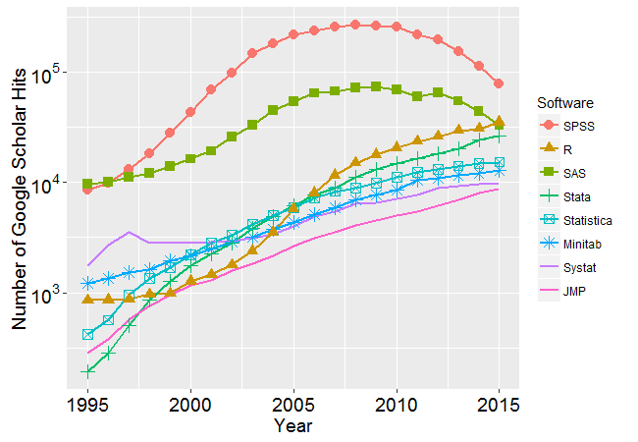
Why R?
A logarithmic view of the number of scholarly articles found in each year by Google Scholar.
Note the y-axis is base 10 logarithm.

Slide 15
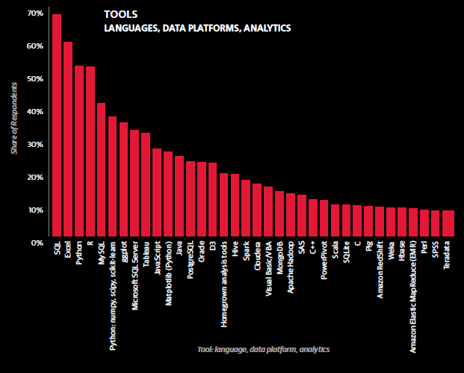
Tools used by 2015 respondents to O’Reilly 2015 salary survey.

Slide 16
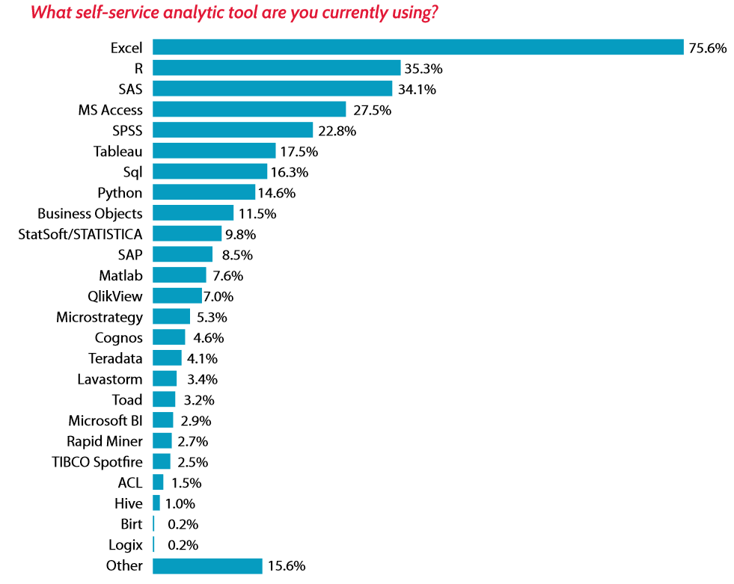
Lavastorm survey of analytics tools.

Slide 17
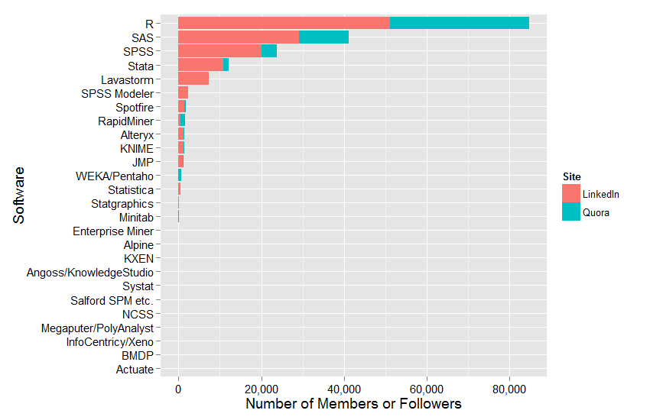
Number of people who follow each software on LinkedIn and Quara.

Slide 18
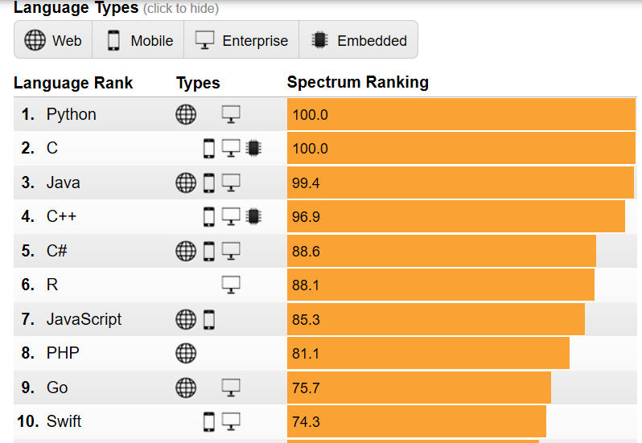
IEEE Spectrum language popularity rankings (2017).
Notes:
https://spectrum.ieee.org/static/interactive-the-top-programming-languages-2017

Slide 19
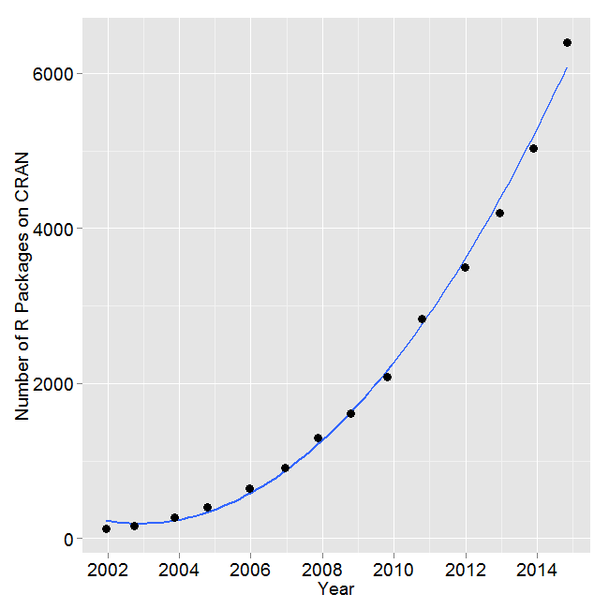
Number of R packages available on its main distribution site for the last version released in each year.

Slide 20
R Development Environment
R can be downloaded from www.r-project.org
The classic R console works OK on Windows
But the R source editor is not very user friendly
Our choice: R classic and Notepad++
Notepad++ (https://notepad-plus-plus.org/)
A powerful text editor
Syntax highlighting for popular programming interface (including R)
Available for Windows only (not Mac)
Mac users can use other text editors (e.g., https://www.sublimetext.com/)
Another choice is RStudio (https://www.rstudio.com/)
Provided integrated development environment
We will not use Rstudio in this class ☼

Slide 21
R Development Environment (Cont’d.)
R classic and notepad++ provide lightweight and robust development environment
RStudio does not always produce compatible results
In most cases, RStudio and R will produce identical results.
If you need to run your script on different operation systems, R classic is the best choice.
Another reason is RSAND.
RSAND stands for R的Sandbox
Part of your assignments need to be completed on RSAND
Develop and submit your R code, RSAND will check whether your code is correct.
RSAND uses a Linux-based command line interface (SSH).
You can edit your R programs via winscp + notepad++ (for Windows users) ☼

Slide 22
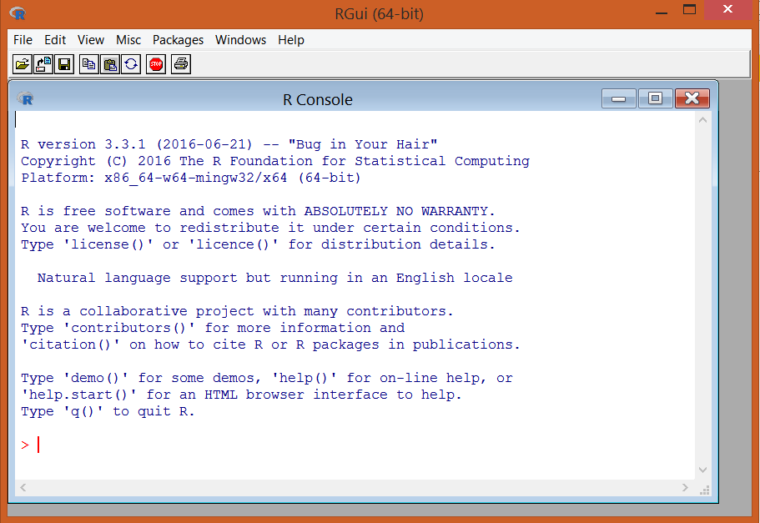
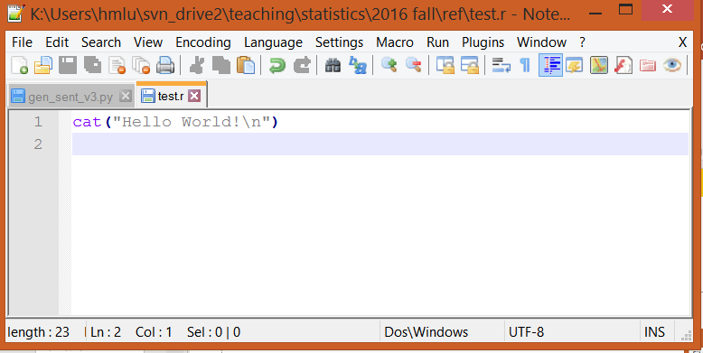
Setup Your R Environment
Download R setup file from https://ftp.yzu.edu.tw/CRAN/
Run R-3.4.x-win.exe and accept default setting.
Run “R x64 3.4.x,” you will see the R classic console.
Download notepad++ from https://notepad-plus-plus.org/repository/7.x/7.5.1/npp.7.5.1.Installer.exe
Run the setup file and you will have notepad++ install on your computer.

Slide 23
Get and Set Working Directory
You need to know your current working directory in order to read and write data files correctly.
getwd(): Retrieve your current working directory
setwd(): Set your working directory
Example:
> getwd()
[1] "C:/Users/hsinm_000/Documents"
Switching to K:\r_demo\ch5
> setwd('K:\\r_demo\\ch5')
> getwd()
[1] "K:/r_demo/ch5“
Note the double back slash (“\\”) in setwd().
Why? Back slash is the “escape character” in R and many other languages.
Use double back slash to represent the “normal” back slash ☼

Slide 24
Reading CSV File
Reading CSV file can be accomplished by read.csv()
The head() command returns the first 6 rows of the data content. Good for verifying the content.
> gss1 = read.csv('GSS2002_sub1.csv')
> head(gss1)
id AGE SEX RACE CONINC CONRINC INCOME98 RINCOM98 EDUC SPEDUC PAEDUC MAEDUC
1 1 25 2 1 31618 31618 16 16 14 NA 12 12
2 2 43 1 1 160197 80261 23 21 16 14 12 12
3 3 30 2 1 36482 36482 17 17 13 NA 12 NA
4 4 55 2 1 160197 53507 23 19 2 NA 8 8
5 5 37 1 1 43779 43779 18 18 7 NA 16 10
6 6 47 1 1 97286 43779 22 18 12 NA 8 8
DEGREE SPDEG PADEG MADEG WRKSTAT HRS
1 1 NA 1 1 1 40
2 3 1 1 1 1 72
3 1 NA 1 NA 1 40
4 0 NA 0 0 1 60
5 0 NA 4 1 1 40
6 1 NA 0 0 1 42 ☼

Slide 25
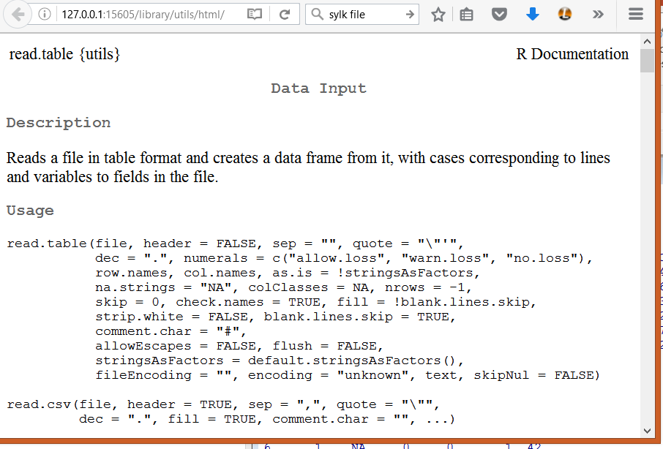
Reading CSV File
Use help(read.csv) to retrieve online manual.

Slide 26
Assignment Operators
“<-” and “=“ assign values to a variable
> b3=523
> b4<-777
> b3
[1] 523
> b4
[1] 777
What is the difference?
The operator <- can be used anywhere,
The operator = is only allowed at the top level (e.g., in the complete expression typed at the command prompt) or as one of the subexpressions in a braced list of expressions.
See example in the next slide. ☼

Slide 27
Assignment Operators (Cont’d.)
rnorm() can be used to generated standard normal random variables. Draw 3 values from standard normal distribution:
> rnorm(3)
[1] -1.2193097 0.2402945 -0.8487626
Let construct a big random matrix:
a=matrix(rnorm(1000000), nrow=1000, ncol=1000)
> a[1:5, 1:5]
[,1] [,2] [,3] [,4] [,5]
[1,] 1.4277501 0.2714817 -0.3388035 -0.31246024 0.6116100
[2,] 1.1993680 0.9049378 0.3035079 -0.55304539 0.2051553
[3,] 0.5056361 -0.5257070 1.6797033 0.97529568 0.4351459
[4,] 1.3797358 -1.2452939 -1.5874884 0.40542390 -0.9033644
[5,] -1.0937191 1.8351651 -1.0327077 0.09482332 2.5960536
We can compute the inverse of a (since it is a square matrix, and most random matrices are nonsingular)
b=solve(a) ☼

Slide 28
Execution Time
system.time(r_code) can time the execution time of r_code.
> system.time(b=solve(a))
Error in system.time(b = solve(a)) : unused argument (b = solve(a))
The error occur because “=“ can only be used at top level.
Need to replace “=“ with “<-” here…
> system.time(b <- solve(a))
user system elapsed
0.68 0.00 0.67
Use help(system.time) to see additional information on this command. ☼

Slide 29
Printing
> x1=1:15
> x1
[1] 1 2 3 4 5 6 7 8 9 10 11 12 13 14 15
The : operator is used to create integer sequences.
cat("x1 sequence", x1, "\n")
x1 sequence 1 2 3 4 5 6 7 8 9 10 11 12 13 14 15
cat() is a little bit like printf in C.
> print(x1)
[1] 1 2 3 4 5 6 7 8 9 10 11 12 13 14 15
print() output the content of a variable. ☼

Slide 30
R Data Types
Useful basic data types:
logical (TRUE/FALSE)
integer
double (real number)
complex (complex number)
character (string)
Vector: contiguous cells containing data.
Access through integer indexing operations
You can construct a vector of: logical, integer, double, complex.
List is a general data structure that can have many elements.
Each element can be of different types
Indexing through integer or character strings. ☼

Slide 31
Numbers
Numbers in R can be integer or double.
Add the L suffix if you want integer
> x1=523
> x2=523L
> typeof(x1)
[1] "double"
> typeof(x2)
[1] "integer"
typeof() returns the low-level data types of a variable.
There is also a special number Inf which represents infinity;
> 1/0
[1] Inf
> 1/Inf
[1] 0
The value NaN represents an undefined value (“not a number”)
E.g., a missing value or 0/0 ☼

Slide 32
Attributes
All R variables are objects that can have attributes such as
names, dimnames
dimensions (e.g. matrices, arrays)
class
length
other user-defined attributes/metadata
Attributes of an object can be accessed using the attributes() function.
> a=matrix(0, nrow=15, ncol=10)
> attributes(a)
$dim
[1] 15 10
> dim(a)
[1] 15 10 ☼

Slide 33
Vectors
The c() function can be used to create vectors:
x <- c(0.5, 0.6) ## numeric
x <- c(TRUE, FALSE) ## logical
x <- c(T, F) ## logical
x <- c("a", "b", "c") ## character
x <- 9:29 ## integer
x <- c(1+0i, 2+4i) ## complex
The vector() function can be used to initialized a vector:
> x <- vector("double", length = 10)
> x
[1] 0 0 0 0 0 0 0 0 0 0 ☼

Slide 34
Mixing Data Types?
What will happen?
y1 <- c(1.7, "a")
y2 <- c(TRUE, 2)
y3 <- c("a", TRUE)
When different objects are mixed in a vector, coercion occurs so that every element in the vector is of the same class.
> y1
[1] "1.7" "a"
> y2
[1] 1 2
> y3
[1] "a" "TRUE" ☼

Slide 35
Explicit Coercion
You can explicitly coerce a variable using as.* function
> x <- 0:6
> typeof(x)
[1] "integer"
> as.numeric(x)
[1] 0 1 2 3 4 5 6
> as.logical(x)
[1] FALSE TRUE TRUE TRUE TRUE TRUE TRUE
> as.character(x)
[1] "0" "1" "2" "3" "4" "5" "6"
Note: “numeric” data type is identical to the “double” data type. ☼

Slide 36
Coercion has Limits
Note the limitations of coercion
> x <- c("a", "b", "c")
> as.numeric(x)
[1] NA NA NA
Warning message:
NAs introduced by coercion
> as.logical(x)
[1] NA NA NA
> as.complex(x)
[1] NA NA NA
Warning message:
NAs introduced by coercion ☼

Slide 37
Matrices
Creating matrix:
> m <- matrix(nrow = 2, ncol = 3)
> m
[,1] [,2] [,3]
[1,] NA NA NA
[2,] NA NA NA
> dim(m)
[1] 2 3
> attributes(m)
$dim
[1] 2 3

Slide 38
Matrices (cont’d.)
Matrices are constructed column-wise, so entries can be thought of starting in the “upper left” corner and running down the columns.
> m <- matrix(1:6, nrow = 2, ncol = 3)
> m
[,1] [,2] [,3]
[1,] 1 3 5
[2,] 2 4 6

Slide 39
Matrix Operations
%*%: Matrix multiplication.
*: Element-by-element Multiplication.
+ and -: Element-by-element + and -.
> a1 = matrix(c(1,2,3,4,5,6), byrow=FALSE, ncol=2)
> a2 = matrix(c(1,2,3,4,5,6), byrow=TRUE, nrow=2)
> a3 = matrix(c(1,0,0,0,1,1), byrow=FALSE, ncol=2)
> a1
[,1] [,2]
[1,] 1 4
[2,] 2 5
[3,] 3 6
> a2
[,1] [,2] [,3]
[1,] 1 2 3
[2,] 4 5 6
> a3
[,1] [,2]
[1,] 1 0
[2,] 0 1
[3,] 0 1
>

Slide 40
Matrix Operations
> a1
[,1] [,2]
[1,] 1 4
[2,] 2 5
[3,] 3 6
> a2
[,1] [,2] [,3]
[1,] 1 2 3
[2,] 4 5 6
> a3
[,1] [,2]
[1,] 1 0
[2,] 0 1
[3,] 0 1
>
> #matrix multiplication
> a1 %*% a2
[,1] [,2] [,3]
[1,] 17 22 27
[2,] 22 29 36
[3,] 27 36 45
> a1 %*% a3
Error in a1 %*% a3 : non-conformable arguments
> #element-by-element operations
> a1 * a2
Error in a1 * a2 : non-conformable arrays
> a1 * a3
[,1] [,2]
[1,] 1 0
[2,] 0 5
[3,] 0 6

Slide 41
cbind and rbind
Matrices can be created by column-binding or row-binding with cbind() and rbind().
> x <- 1:3
> y <- 10:12
> cbind(x, y)
x y
[1,] 1 10
[2,] 2 11
[3,] 3 12
> rbind(x, y)
[,1] [,2] [,3]
x 1 2 3
y 10 11 12

Slide 42
Lists
Lists are a special type of vector that can contain elements of different classes.
Lists are a very important data type in R and you should get to know them well.
Similar to the “dictionary” in Python or associative array in PHP.
> x <- list(1, "a", TRUE, 1 + 4i)
> x
[[1]]
[1] 1
[[2]]
[1] "a"
[[3]]
[1] TRUE
[[4]]
[1] 1+4i ☼

Slide 43
Data Frame
Data frames are used to store tabular data
They are represented as a special type of list where every element of the list has to have the same length
Each element of the list can be thought of as a column and the length of each element of the list is the number of rows
Unlike matrices, data frames can store different classes of objects in each column (just like lists);
matrices must have every element be the same class
Data frames also have a special attribute called row.names
Data frames are usually created by calling read.table() or read.csv()
Can be converted to a matrix by calling data.matrix() or as.matrix() ☼

Slide 44
Missing Values
Missing values are denoted by NA or NaN for undefined mathematical operations.
is.na() is used to test objects if they are NA
is.nan() is used to test for NaN
A NaN value is also NA but the converse is not true.
> x1 <- c(1, 2, NA, 10, 3)
> is.na(x1)
[1] FALSE FALSE TRUE FALSE FALSE
> is.nan(x1)
[1] FALSE FALSE FALSE FALSE FALSE
> x2 <- c(1, 2, NaN, NA, 4)
> is.na(x2)
[1] FALSE FALSE TRUE TRUE FALSE
> is.nan(x2)
[1] FALSE FALSE TRUE FALSE FALSE ☼

Slide 45
Names: Vectors
R objects can also have names, which is very useful for writing readable code and self-describing objects.
> x <- 1:3
> names(x)
NULL
> NULL
NULL
> names(x) <- c("foo", "bar", "norf")
> x
foo bar norf
1 2 3
> names(x)
[1] "foo" "bar" "norf"

Slide 46
Names: Lists
List can be indexed by names or integers
> x <- list(a = 1, b = 2, c = 3, d="hello")
> x
$a
[1] 1
$b
[1] 2
$c
[1] 3
$d
[1] "hello"
> x$c
[1] 3
> x[["c"]]
[1] 3
> x[[3]]
[1] 3
> x[[4]]
[1] "hello" ☼

Slide 47
Names: Matrices
Rows and columns of a matrix can have names, too.
> m <- matrix(1:4, nrow = 2, ncol = 2)
> m
[,1] [,2]
[1,] 1 3
[2,] 2 4
> colnames(m) = c("col1", "col2")
> rownames(m) = c("row1", "row2")
> m
col1 col2
row1 1 3
row2 2 4

Slide 48
class and typeof
class() returns the object class of a variable
typeof() returns to low-level data structure of individual elements
> x1=3.23
> typeof(x1)
[1] "double"
> class(x1)
[1] "numeric"
> x2=5:9
> typeof(x2)
[1] "integer"
> class(x2)
[1] "integer"
> is.vector(x2)
[1] TRUE
> x3=matrix(1:6, nrow=3)
> typeof(x3)
[1] "integer"
> class(x3)
[1] "matrix“
> x4 = list(a=3.5, b="dd")
> typeof(x4)
[1] "list"
> class(x4)
[1] "list“
is.list(x4) ☼

Slide 49
Reading Data
read.csv, for reading tabular data.
loadWorkbook and readWorksheet (from XLConnect library) to read Excel data files.
source, for reading and executing R source files
You can use absolute path, or
If you want to use relative path, make sure your working directory has been properly setup.
Use getwd() and setwd()
In command line mode: CD to the working dir and launch R or Rscript (for batch model processing).
Notes:
load and save, for loading and saving variables in R native format.

Slide 50
Reading CSV Files
Support our working dir is K:/r_demo/ch5 and we are reading the CSV file GSS2002_sub1.csv
> getwd()
[1] "K:/r_demo/ch5"
> setwd("K:\\r_demo\\ch5")
> df1 = read.csv("GSS2002_sub1.csv")
> class(df1)
[1] "data.frame"
> class(df1$id)
[1] "integer"
> class(df1$AGE)
[1] "integer"
> class(df1$location)
[1] "factor"
> head(df1)
id AGE SEX CONINC CONRINC location
1 1 25 2 31618 31618 us
2 2 43 1 160197 80261 us
3 3 30 2 36482 36482 us
4 4 55 2 160197 53507 tw
5 5 37 1 43779 43779 tw
6 6 47 1 97286 43779 tw

Slide 51
Reading CSV Files (cont’d.)
The default setting is to convert columns with strings as factors
> df1$location
[1] us us us tw tw tw us us us tw tw tw us us us tw tw tw us us us tw tw tw us
[26] us us tw tw tw us us us tw tw tw us us us tw tw tw us us us tw tw tw us us
[51] us tw tw tw us us us tw tw tw us us us tw tw tw us us us tw tw tw us us us
[76] tw tw tw us us us tw tw tw us us us tw tw tw us us us tw tw tw us us us tw
Levels: tw us
Converting to factors may reduce IO speed in some cases.
Preserving string columns and not converting to factors is a good practice in most cases.
> df1 = read.csv("GSS2002_sub1.csv", stringsAsFactors=FALSE)
> class(df1$location)
[1] "character"
fix(df1)
fix() provide a GUI for direct data editing

Slide 52
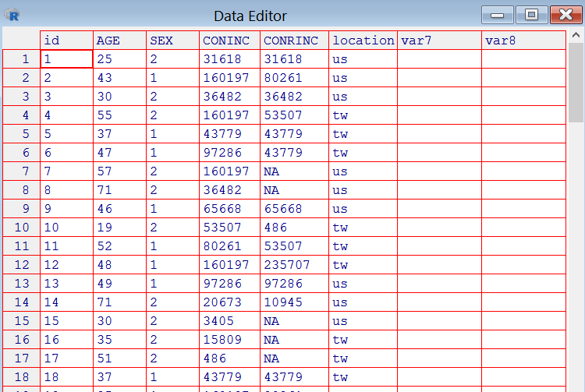
fix() provide a GUI for direct data editing

Slide 53
Reading XLS Files
XLConnect library provides Excel data reading reading and writing functionality
Based on a Java library
Need to install Java on your machine
Install XLConnect library
Make sure Java Development Kits are properly installed.
To check, open cmd and enter “java -version”
You should see something like this:
C:\Users\hsinm_000\Downloads>java -version
java version "1.8.0_91"
Java(TM) SE Runtime Environment (build 1.8.0_91-b14)
Java HotSpot(TM) 64-Bit Server VM (build 25.91-b14, mixed mode) ☼

Slide 54
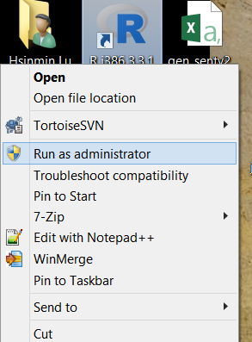
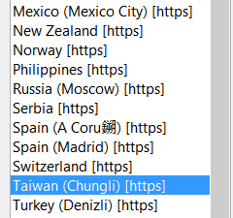
Install XLConnect library
Launch R as administrator (optional)
Right click an R icon and select “Run as Administrator”
Run the following command:
install.packages(‘rJava’)
install.packages(‘XLConnect’)
Note: select a mirror that is close to you.
You can close this R instance after successfully installed the R packages
If you did not run R as the administrator, you can still install the packages. However, you will not be able to use this packages if you login as another user.

Slide 55
XLConnect Library
Load the library:
> library(XLConnect)
Loading required package: XLConnectJars
XLConnect 0.2-12 by Mirai Solutions GmbH [aut],
Martin Studer [cre],
The Apache Software Foundation [ctb, cph] (Apache POI, Apache Commons
Codec),
Stephen Colebourne [ctb, cph] (Joda-Time Java library),
Graph Builder [ctb, cph] (Curvesapi Java library)
http://www.mirai-solutions.com ,
http://miraisolutions.wordpress.com
Let’s load an Excel spreadsheet
> setwd("K:\\r_demo\\ch5")
> fileXls = "GSS2002_sub1.xlsx"
> exc <- loadWorkbook(fileXls)
> df2 <- readWorksheet(exc,1)
> head(df2)
id AGE SEX CONINC CONRINC location
1 1 25 2 31618 31618 us
2 2 43 1 160197 80261 us
3 3 30 2 36482 36482 us
4 4 55 2 160197 53507 tw
5 5 37 1 43779 43779 tw
6 6 47 1 97286 43779 tw
> class(df2)
[1] "data.frame" ☼
Important: RSAND will only support XLConnect to read xlsx file!

Slide 56
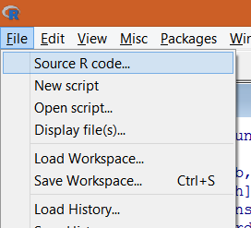
Sourcing R Script File
source() can be used to load and run a R script file.
Click File → Source R code to run a R script file.
This GUI event essentially trigger the R console to execute a source command. E.g.: source("K:\\r_demo\\ch5\\test2.r")
You can type in the command by yourself.
Drag-and-drop the source file to R window can do the job.
Use getwd() and setwd() to setup the working directory and you will be able to source a R script file via relative path. ☼

Slide 57
Subsetting
Subsetting return a subset of the original data.
[ returns an object (vector or matrix) of the same class as the original; can be used to select more than one element.
[[ is used to extract elements of a list or a data frame; it can only be used to extract a single element and the class of the returned object will not necessarily be a list or data frame
$ is used to extract elements of a list or data frame by name; semantics are similar to that of [[. ☼

Slide 58
Subsetting Vectors
> x <- c("a", "b", "c", "c", "d", "a")
> x[1]
[1] "a"
> x[2]
[1] "b"
> x[1:4]
[1] "a" "b" "c" "c"
> x[x > "a"]
[1] "b" "c" "c" "d"
> u <- x > "a"
> u
[1] FALSE TRUE TRUE TRUE TRUE FALSE
> x[u]
[1] "b" "c" "c" "d"

Slide 59
Subsetting Lists
> x <- list(foo = 1:4, bar = 0.6)
> x[1]
$foo
[1] 1 2 3 4
> x$foo
[1] 1 2 3 4
> x[[1]]
[1] 1 2 3 4
> x$bar
[1] 0.6
> x[["bar"]]
[1] 0.6
> x["bar"]
$bar
[1] 0.6
> x <- list(foo = 1:4, bar = 0.6, baz = "hello")
> x[c(1, 3)]
$foo
[1] 1 2 3 4
$baz
[1] "hello" ☼

Slide 60
Subsetting Lists
[[ operator can be used with computed indices.
$ can only be used with literal names.
> x <- list(foo = 1:4, bar = 0.6, baz = "hello")
> name <- "foo"
> x[[name]] ## computed index for ‘foo’
[1] 1 2 3 4
> x$name ## element ‘name’ doesn’t exist!
NULL
> x$foo
[1] 1 2 3 4

Slide 61
Subsetting a Matrix
Retrieve a element using the (i,j) index
> x <- matrix(1:6, 2, 3)
> x[1, 2]
[1] 3
> x[2, 1]
[1] 2
Getting a row or a column:
> x[1, ]
[1] 1 3 5
> x[, 2]
[1] 3 4

Slide 62
Subsetting a Matrix (cont’d.)
By default, when a single element of a matrix is retrieved, it is returned as a vector of length 1 rather than a 1 × 1 matrix. This behavior can be turned off by setting drop = FALSE.
> x <- matrix(1:6, 2, 3)
> x[1, 2]
[1] 3
> x[1, 2, drop = FALSE]
[,1]
[1,] 3
By default, Subsetting a single column or a single row will give you a vector, not a matrix.
> x <- matrix(1:6, 2, 3)
> x[1, ]
[1] 1 3 5
> x[1, , drop = FALSE]
[,1] [,2] [,3]
[1,] 1 3 5

Slide 63
Control Structure
Control structures in R allow you to control the flow of execution of the program, depending on runtime conditions. Common structures are
if, else: testing a condition
for: execute a loop a fixed number of times
while: execute a loop while a condition is true
repeat: execute an infinite loop
break: break the execution of a loop
next: skip an interation of a loop
return: exit a function
Most control structures are not used in interactive sessions, but rather when writing functions or longer expresisons.

Slide 64
Control Structure: if
Example 1:
if(x > 3) {
y <- 10
} else {
y <- 0
} ☼
if(<condition>) {
## do something
} else {
## do something else
}
if(<condition1>) {
## do something
} else if(<condition2>) {
## do something different
} else {
## do something different
}

Slide 65
Control Structure: for Loop
for loops take an interator variable and assign it successive values from a sequence or vector.
for loops are most commonly used for iterating over the elements of an object (list, vector, etc.).
for(i in 1:10) {
print(i)
}
This for loop take a list c(1,2,3,4,5,6,7,8,9,10), and assign i to each element in the list. So i takes the value of 1, 2, 3, …, 10, and then exit. ☼

Slide 66
for loop: Examples
Consider the following examples:
x <- c("a", "b", "c", "d")
for(i in 1:4) {
print(x[i])
}
for(i in seq_along(x)) {
print(x[i])
}
for(letter in x) {
print(letter)
}
for(i in 1:4) print(x[i])
All of these loops have the same output:
[1] "a"
[1] "b"
[1] "c"
[1] "d"

Slide 67
Nested for loops
for loops can be nested
x <- matrix(1:6, 2, 3)
for(i in seq_len(nrow(x))) {
for(j in seq_len(ncol(x))) {
print(x[i,j])
}
}
Note: deeply nested for loops often takes a very long time to run.
> x
[,1] [,2] [,3]
[1,] 1 3 5
[2,] 2 4 6
Output:
[1] 1
[1] 3
[1] 5
[1] 2
[1] 4
[1] 6 ☼

Slide 68
Control Structure: while loop
While loops begin by testing a condition. If it is true, then they execute the loop body.
Once the loop body is executed, the condition is tested again, and so forth.
While loops can potentially result in infinite loops if not written properly. Use with care!
count <- 0
while(count < 10) {
print(count)
count <- count + 1
}
Output:
[1] 0
[1] 1
[1] 2
[1] 3
[1] 4
[1] 5
[1] 6
[1] 7
[1] 8
[1] 9 ☼

Slide 69
while loop: Example
Testing more than one conditions (conditions are always evaluated from left to right):
z <- 5
while(z >= 3 && z <= 10) {
print(z)
coin <- rbinom(1, 1, 0.5) #draw a binomial random variable
if(coin == 1) { ## random walk
z <- z + 1
} else {
z <- z - 1
}
}

Slide 70
break and next
break breaks out of a for, or while loop;
control is transferred to the first statement outside the inner-most loop.
next halts the processing of the current iteration and advances the looping index.
Both break and next apply only to the innermost of nested loops.
set.seed(33221)
count=0
while(1) {
count = count + 1
coin <- rbinom(1, 1, 0.5)
if(coin == 1) {
break
}
}
cat("It takes", count, "draw to get a head\n")
Output: It takes 3 draw to get a head ☼

Slide 71
next: Example
x <- 1:5
for (val in x) {
if (val == 3){
next
}
print(val)
}
Output:
[1] 1
[1] 2
[1] 4
[1] 5 ☼

Slide 72
Functions
Functions are created using the function() directive and are stored as R objects just like anything else.
They are R objects of class “function”.
Functions can be passed as arguments to other functions
Functions can be nested, so that you can define a function inside of another function
The return value of a function is the last expression in the function body to be evaluated.
f <- function(<arguments>) {
## Do something interesting
} ☼

Slide 73
Function Arguments
Functions have named arguments which potentially have default values.
The formal arguments are the arguments included in the function definition
A function can use only a subset of the formal arguments
Function arguments can be missing or might have default values
Notes:
The formals function returns a list of all the formal arguments of a function

Slide 74
Argument Matching
R functions arguments can be matched by position or by name.
So the following calls to sd are all equivalent
mydata <- rnorm(100)
sd(mydata)
sd(x = mydata)
sd(x = mydata, na.rm = FALSE)
sd(na.rm = FALSE, x = mydata)
sd(na.rm = FALSE, mydata)
Better follow the default order to avoid confusion… ☼

Slide 75
Argument Matching (cont’d.)
You can mix positional matching with matching by name. When an argument is matched by name, it is “taken out” of the argument list and the remaining unnamed arguments are matched in the order that they are listed in the function definition.
> args(lm)
function (formula, data, subset, weights, na.action, method = "qr",
model = TRUE, x = FALSE, y = FALSE, qr = TRUE, singular.ok = TRUE,
contrasts = NULL, offset, ...)
The following two calls are equivalent.
lm(data = mydata, y ~ x, model = FALSE, 1:100)
lm(y ~ x, mydata, 1:100, model = FALSE) ☼

Slide 76
Argument Matching (cont’d.)
Most of the time, named arguments are useful on the command line when you have a long argument list and you want to use the defaults for everything except for an argument near the end of the list
Named arguments also help if you can remember the name of the argument and not its position on the argument list (plotting is a good example).
Function arguments can also be partially matched, which is useful for interactive work. The order of operations when given an argument is
1. Check for exact match for a named argument
2. Check for a partial match
3. Check for a positional match ☼

Slide 77
Defining a Function
f <- function(a, b = 1, c = 2, d = NULL) {
cat("d is ", d, "\n")
return(a*b*c)
}
a does not have a default value.
d has a NULL value.
> f(3)
d is
[1] 6
> f(3, d="aaa")
d is aaa
[1] 6
> f()
d is
Error in f() : argument "a" is missing, with no default ☼

Slide 78
Practice 1: mytmean
Write a function named mytmean to compute the mean of a vector after trimming the top 10 and bottom 10% of records.
Input: a vector of numbers
Output: trimmed mean of the vector.
RSAND TaskID: pract1
Check correctness: check_pract1 your_program
Disclaimer: These examples are for you to practice R skills. There may be other functions available that can do the same task better and faster.
See mytmean1.r

Slide 79
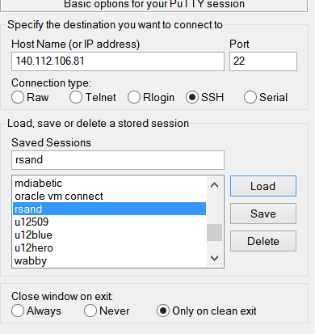
Practice 1: mytmean on RSAND
Testing your code on RSAND.
Every student has an account on RSAND (rsand.lu.im.ntu.edu.tw; IP: 140.112.106.81)
UserID: your student ID
Password: Will be given to you physically
Access RSAND via SSH:
Install Putty (http://www.chiark.greenend.org.uk/ ~sgtatham/putty/download.html)
Configure your connection setting
Remember to “Save.”

Slide 80
Connecting to RSAND
Welcome message:
login as: b05test1
b05test1@140.112.106.81's password:
Welcome to Ubuntu 14.04.5 LTS (GNU/Linux 4.4.0-31-generic x86_64)
System information as of Wed Oct 19 15:33:30 CST 2016
System load: 0.02 Processes: 148
Usage of /: 0.3% of 997.46GB Users logged in: 2
Memory usage: 3% IP address for eth0: 140.112.106.81
Swap usage: 0%
Graph this data and manage this system at:
https://landscape.canonical.com/
=======
歡迎來到RSAND --- R的Sandbox
本伺服器僅供修習統計學一的學生用於課程相關活動
一般常用指令：
passwd: 更改密碼
quota: 目前檔案額度使用狀況。本伺服器提供每人4GB的儲存空間
who: 列出目前在線使用者
Last login: Wed Oct 19 15:14:09 2016 from 140.112.106.83

Slide 81
RSAND使用提示：
mystatus: 列出目前任務狀態
check_pract1 your_program: [Task pract1] 提交your_program並檢查正確性
check_hw_rsand_q1 your_program: [Task hw_rsand_q1] 提交your_program並檢查正確性
check_hw_rsand_q2 your_program: [Task hw_rsand_q2] 提交your_program並檢查正確性
check_bonus your_program: [Task hw_ch5bonus] 提交your_program並檢查正確性
目前檔案使用額度資訊：
Disk quotas for user b05test1 (uid 1003):
Filesystem blocks quota limit grace files quota limit grace
/dev/sda1 36 4000000 5000000 10 0 0
注意：單位為1K
目前在線使用者(前十筆)：
hmlu pts/1 2016-10-19 14:46 (140.112.106.83)
b05test1 pts/3 2016-10-19 15:14 (140.112.106.83)
b05test1 pts/6 2016-10-19 17:11 (140.112.106.83)

Slide 82
Checking mystatus
b05test1@rsand:~$ mystatus
Your User ID: b05test1
Result Code intrepretation: 0 ==> Success; All other value ==> Failure
[b05test1] You do not have any submission records!
Let’s try this task on RSAND
We need to edit text files on a Linux system
You can use nano, joe, or vim.
Here I provide a simple approach that allow you to use Notepad++ to edit text files on RSAND.

Slide 83
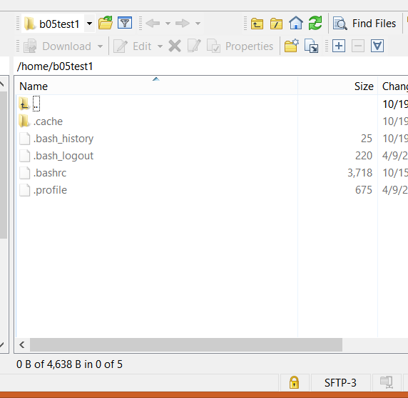
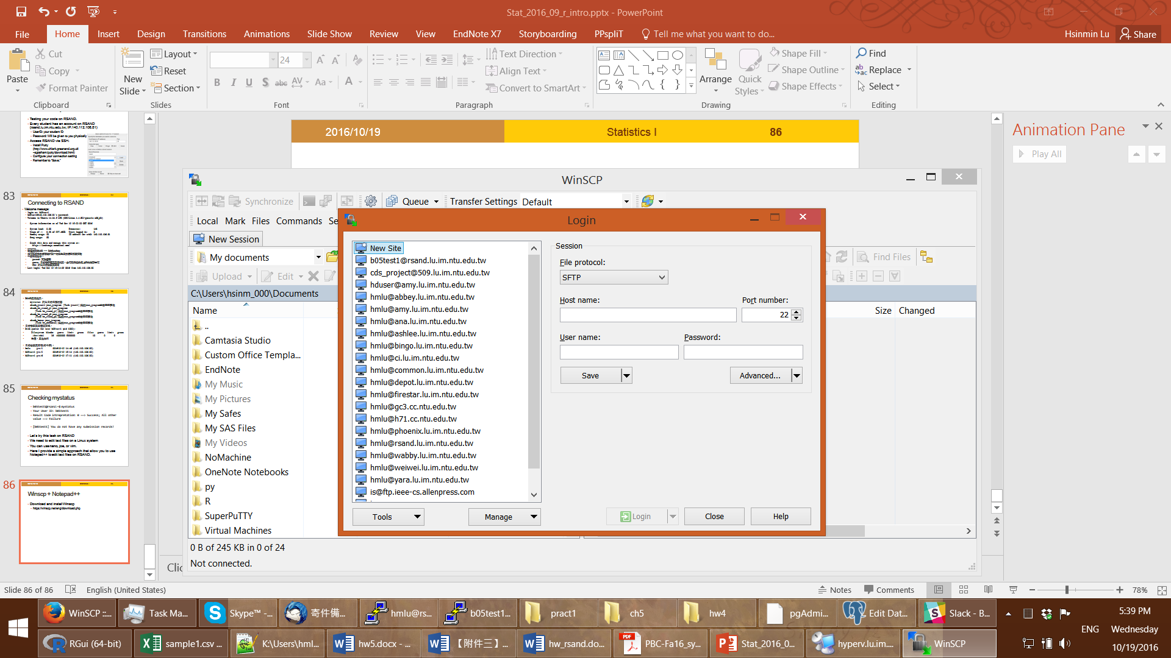
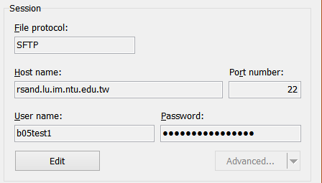
Winscp + Notepad++
Download and install Winscp
https://winscp.net/eng/download.php
Launch Winscp, click on “New Site”
Fill in connection info:
You can save your password so that it is more convenient to connect.
Connect to RSAND

Slide 84
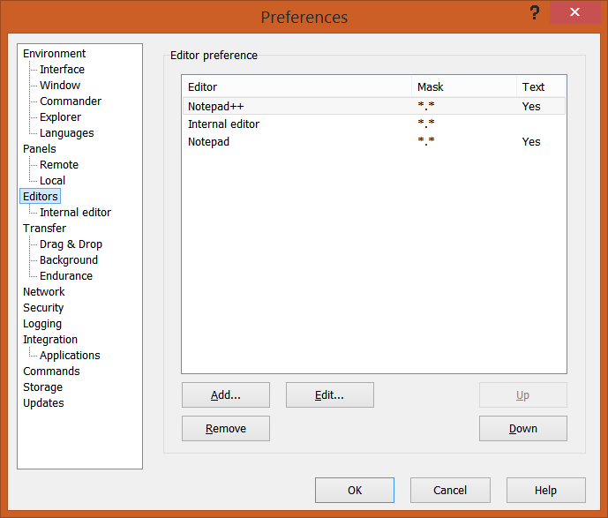
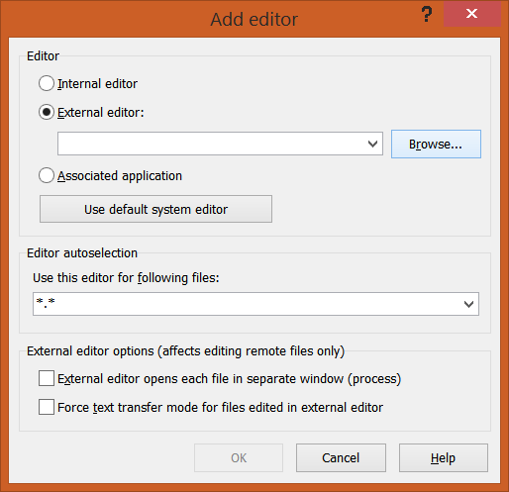
Setup Notepad++ as Winscp Default Text Editor
Options → Preferences → Editors → Add
Select “External editor” and Browse to the path of Notepad++ binary C:\Program Files (x86)\Notepad++\notepad++.exe
Move Notepad++ to the top

Slide 85
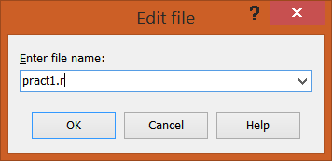
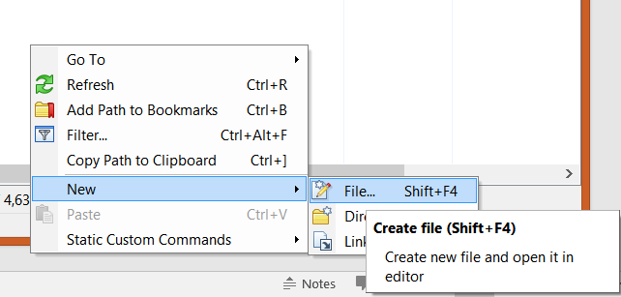
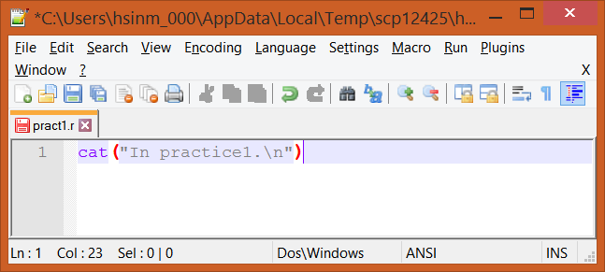
Create a New File at Home
Right click on the right panel, Select “New” → “File” → “Create file”
Enter the file name “pract1.r”
Edit your code and save.
Winscp will save to RSAND automatically

Slide 86
Create a New File at Home (cont’d.)
Verify the code is saved.
b05test1@rsand:~$ cat pract1.r
cat("In practice1.\n")
Run the R file as a script:
b05test1@rsand:~$ Rscript pract1.r
In practice1.

Slide 87
Submitting your code
b05test1@rsand:~$ check_pract1 ./pract1.r
Loading required package: methods
Loading required package: DBI
Homework Task ID: pract1
Running as user: b05test1
Absolute path of testing R script: /home/b05test1/pract1.r
This is your first time working on this task.
=====
Automatic checking started.
Loading function definition from /home/b05test1/pract1.r
In practice1.
Conducting Simple execution test
Report return code -1: Executing command ===:
out1=capture.output(tmp1 <- mytmean(1:10))
=== encountered the following error:Error in eval(expr, envir, enclos): could not find function "mytmean"
Error: The task remains open.
Execution halted

Slide 88
Second Attempt
New version:
mytmean = function(avec) {
m1 = mean(avec)
return(m1)
}
b05test1@rsand:~$ check_pract1 ./pract1.r
Loading required package: methods
Loading required package: DBI
Homework Task ID: pract1
Running as user: b05test1
Absolute path of testing R script: /home/b05test1/pract1.r
!!! Before code checking: You already have 1 failed attempt.
The last failed attempt is at 2016-10-19 20:39:08
Note: We only allow for a maximum of 20 failed attempt for a task.
=====
Automatic checking started.
Loading function definition from /home/b05test1/pract1.r
Conducting Simple execution test
....OK
Conducting specific value check 1
Report return code -1: specific value check 1 failed
Error: The task remains open.
Execution halted

Slide 89
Third Attempt
b05test1@rsand:~$ check_pract1 ./pract1.r
….
!!! Before code checking: You already have 2 failed attempt.
The last failed attempt is at 2016-10-19 20:39:58
Note: We only allow for a maximum of 20 failed attempt for a task.
=====
Automatic checking started.
Loading function definition from /home/b05test1/pract1.r
Conducting Simple execution test
....OK
Conducting specific value check 1
....OK
Conducting specific value check 2
....OK
….
Conducting specific value check 10
....OK
Report return code 0: Everything is OK
Congratulations! You have successfully completed the task!
mytmean = function(avec) {
n=length(avec)
n1 = round(n*0.1)
avec = sort(avec)
avec2 = avec[(n1+1):(n-n1)]
return(mean(avec2))
}

Slide 90
Check mystatus
b05test1@rsand:~$ mystatus
Your User ID: b05test1
Result Code intrepretation: 0 ==> Success; All other value ==> Failure
Listing the last 3 records
HWID: pract1 User ID: b05test1 Record id: 86 Result Code: -1 Timestamp: 2016-10-19 20:39:08.899593
Result msg:
Executing command ===:
out1=capture.output(tmp1 <- mytmean(1:10))
=== encountered the following error:Error in eval(expr, envir, enclos): could not find function "mytmean"
====
HWID: pract1 User ID: b05test1 Record id: 87 Result Code: -1 Timestamp: 2016-10-19 20:39:58.458757
Result msg:
specific value check 1 failed
====
HWID: pract1 User ID: b05test1 Record id: 88 Result Code: 0 Timestamp: 2016-10-19 20:46:02.072486
Task pract1 has completed successfully
====

Slide 91
心法
如果需要額外的練習，可以考慮這個線上課程：http://tryr.codeschool.com/
可以先在自己的電腦做得差不多了，再到RSAND上試試。
只需要給RSAND你的函數定義，你的程式不須呼叫你所定義的函數。
RSAND會呼叫你定義的函數，確認正確性。
你的程式結尾必須有一列空白列!
e.g.:
f <- function(a, b = 1, c = 2, d = NULL) {
cat("d is ", d, "\n")
return(a*b*c)
}
(最後一行在這裡)

Slide 92
R Style Guide
Google R Style Guide
https://google.github.io/styleguide/Rguide.xml
I personally do not follow the guideline, but you can decide by yourself.
Advanced R Style Guide:
http://adv-r.had.co.nz/Style.html
This is closer to my habit.

Slide 93
Factors
The order of the levels can be set using the levels argument to factor().
This can be important in linear modelling because the first level is used as the baseline level.
> x <- factor(c("yes", "yes", "no", "yes", "no"), levels = c("yes", "no"))
> x
[1] yes yes no yes no
Levels: yes no
> as.numeric(x)
[1] 1 1 2 1 2
> x <- factor(c("yes", "yes", "no", "yes", "no"), levels = c("no", "yes"))
> x
[1] yes yes no yes no
Levels: no yes
> as.numeric(x)
[1] 2 2 1 2 1 ☼

Slide 94
Data Frame (cont’d.)
> x = data.frame(foo = 1:4, bar = c(T, T, F, F))
> x
foo bar
1 1 TRUE
2 2 TRUE
3 3 FALSE
4 4 FALSE

